Slide 1

Regular Research Meeting
22/03/2021

Slide 2
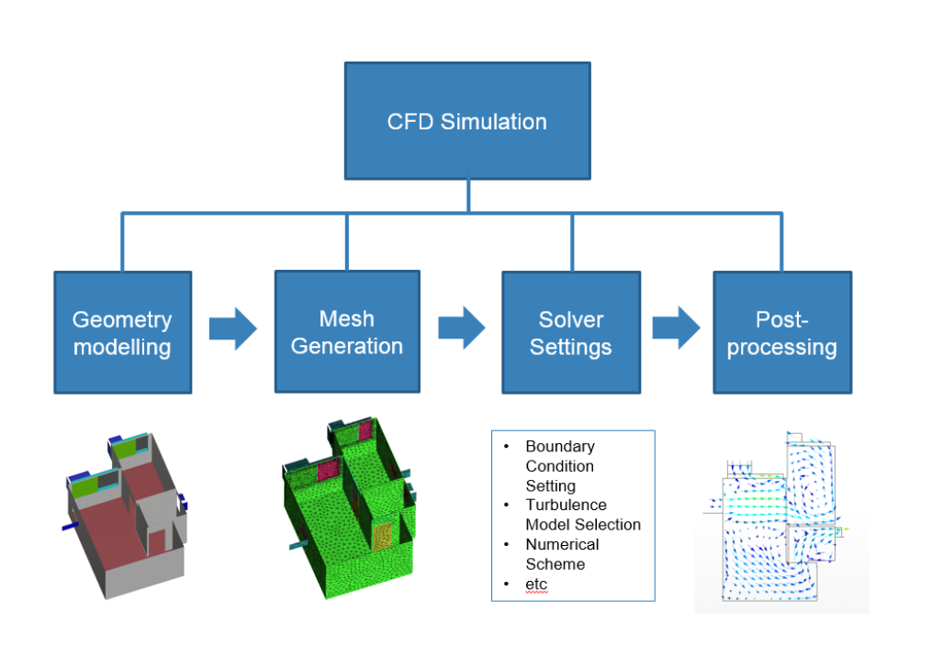
Research Topic
CFD application on natural ventilation design in a built environment
Demands from practitioners in the building industry:
Building designers want reasonable CFD result and short simulation time to optimize design schemes.
Meshing is the most important part of the simulation process.
Quality of mesh impacts the simulation accuracy.
Number of mesh impacts the simulation time.
Page 1

Slide 3
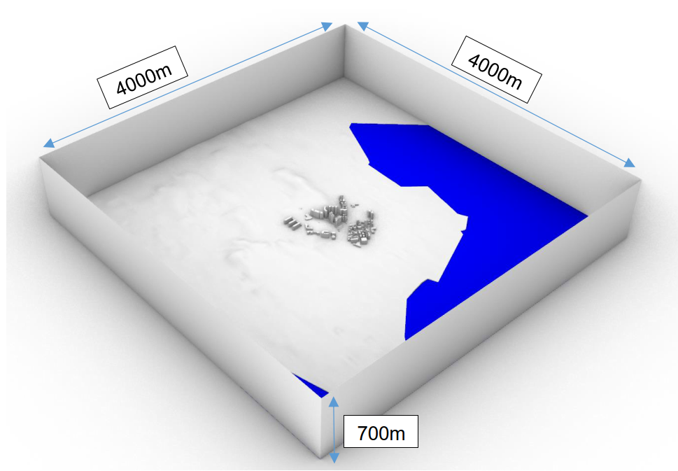
Characteristics of mesh for natural ventilation application
Computational domain is very large in length, width and height;
Wind profile of the atmosphere boundary condition is required;
Coarse mesh is allowable for outer zone while fine mesh is required near building surfaces and ground surfaces;
Boundary layer is required when studying the wind performance at the pedestrian level.
Page 2

Slide 4
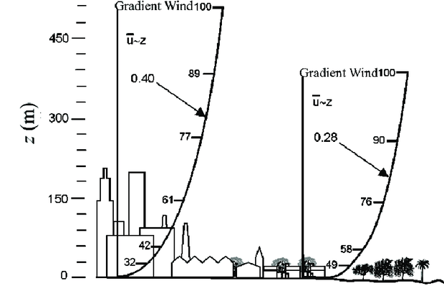
Characteristics of mesh for natural ventilation application
Computational domain is very large in length, width and height;
Wind profile of the atmosphere boundary condition is required;
Coarse mesh is allowable for outer zone while fine mesh is required near building surfaces and ground surfaces;
Boundary layer is required when studying the wind performance at the pedestrian level.
Page 3

Slide 5
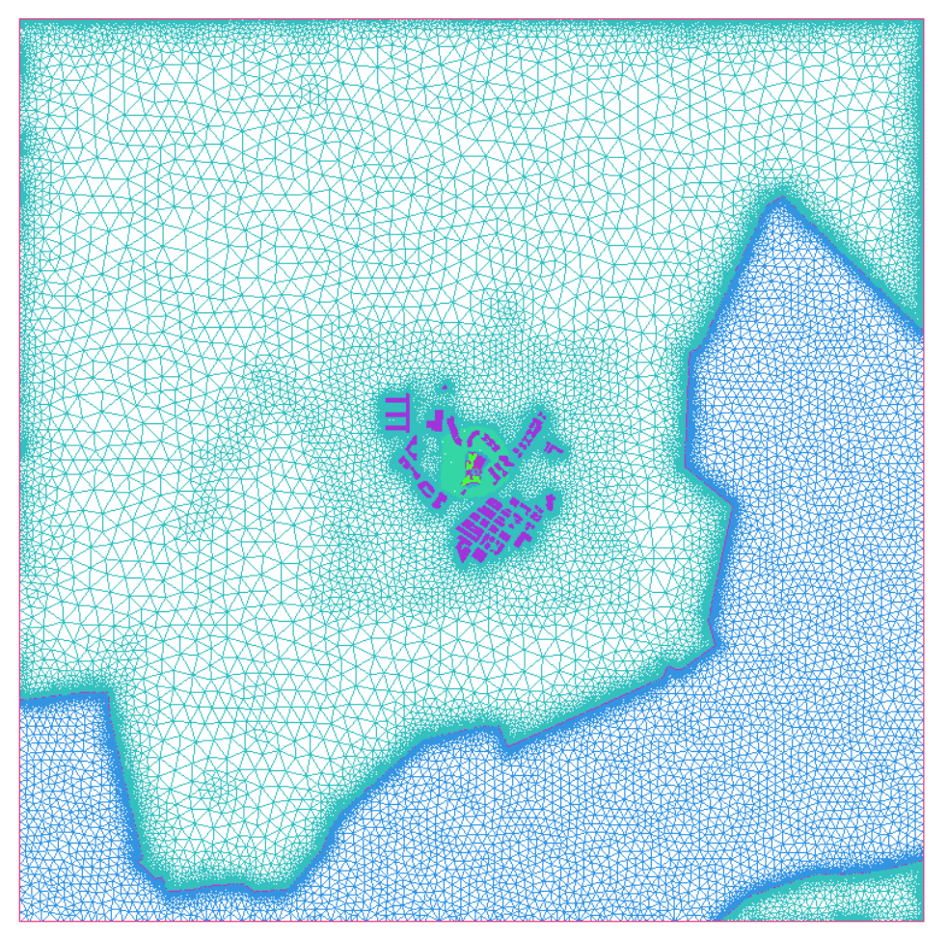
Characteristics of mesh for natural ventilation application
Computational domain is very large in length, width and height;
Wind profile of the atmosphere boundary condition is required;
Coarse mesh is allowable for outer zone while fine mesh is required near building surfaces and ground surfaces;
Boundary layer is required when studying the wind performance at the pedestrian level.
Page 4

Slide 6
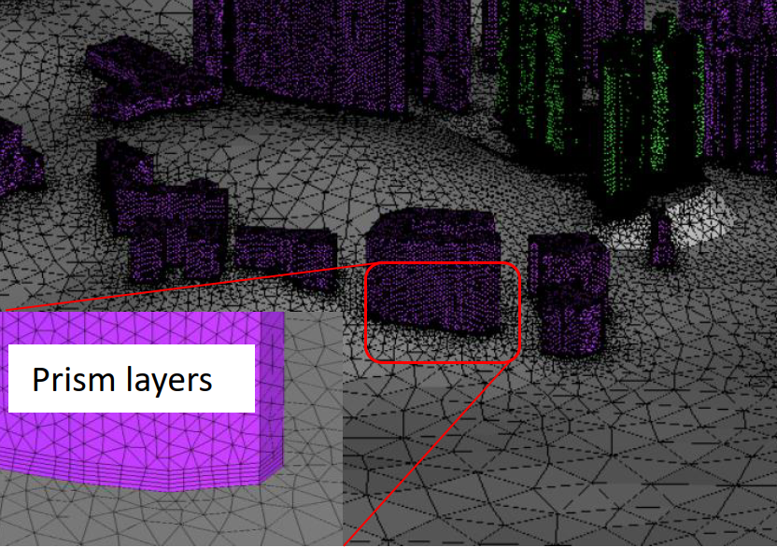
Characteristics of mesh for natural ventilation application
Computational domain is very large in length, width and height;
Wind profile of the atmosphere boundary condition is required;
Coarse mesh is allowable for outer zone while fine mesh is required near building surfaces and ground surfaces;
Boundary layer is required when studying the wind performance at the pedestrian level.
Page 5

Slide 7
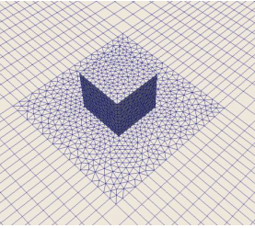
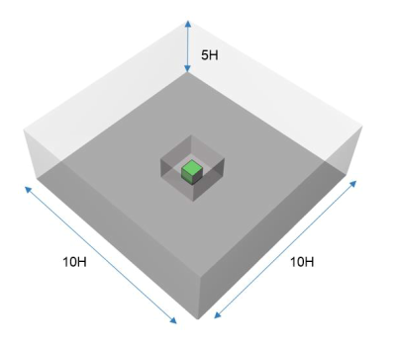
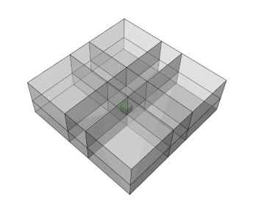
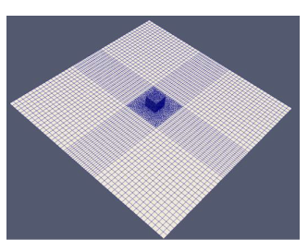
Hybrid mesh
A Solution to the problem:
Hybrid mesh – reduce the number of mesh and keep mesh quality
Outer zone – multiblock and structured grid
Inner zone – tetrahedral grid to capture building features
Page 6

Slide 8
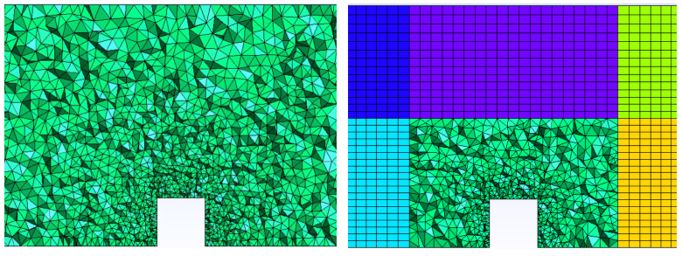
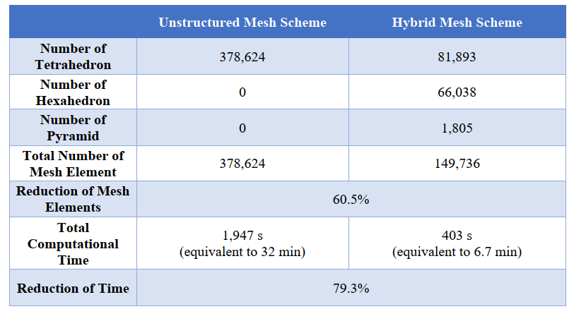
Hybrid mesh
A Solution to the problem:
Hybrid mesh – reduce the number of mesh and keep mesh quality
Outer zone – multiblock and structured grid
Inner zone – tetrahedral grid to capture building features
Page 7

Slide 9
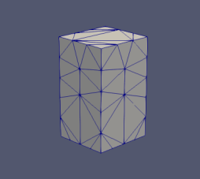
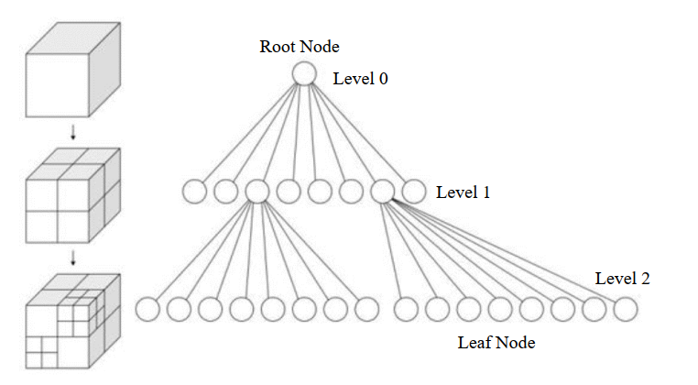
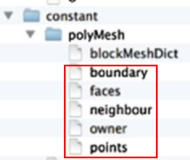
Octree-based hybrid mesh generation algorithm
Further improvement on the hybrid mesh:
Fully automatic meshing process
Flexible mesh density control
Octree-based hybrid mesh generation algorithm
Read STL geometry
Mesh density setting
Automatic meshing
Output OpenFoam format mesh data
Page 8
Sub-blocks are no longer prerequisite for mesh generation;
Each mesh element can be manipulated due to the tree data structure feature;
Each mesh element is dividable.

Slide 10
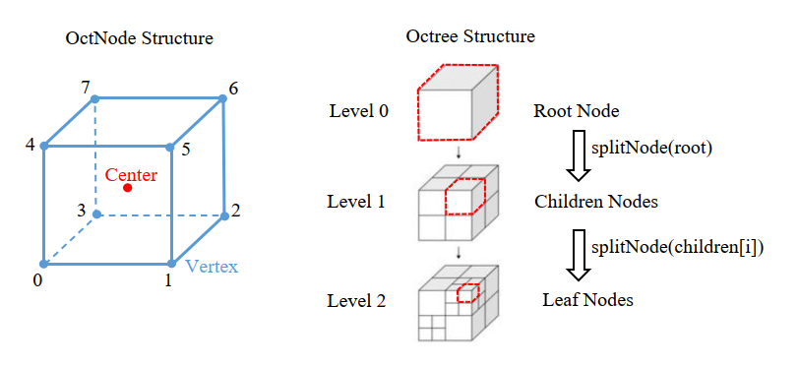
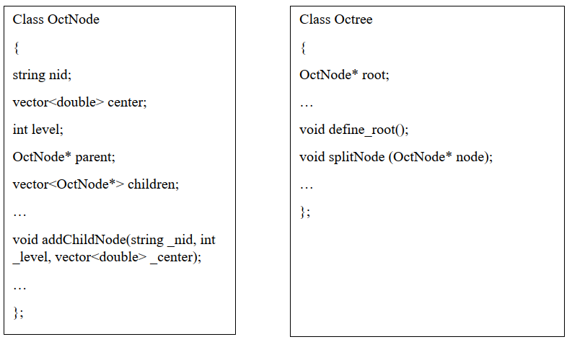
Octree-based hybrid mesh generation algorithm
Algorithm Development in C++
Page 9
Sub-blocks are no longer prerequisite for mesh generation;
Each mesh element can be manipulated due to the tree data structure feature;
Each mesh element is dividable.

Slide 11
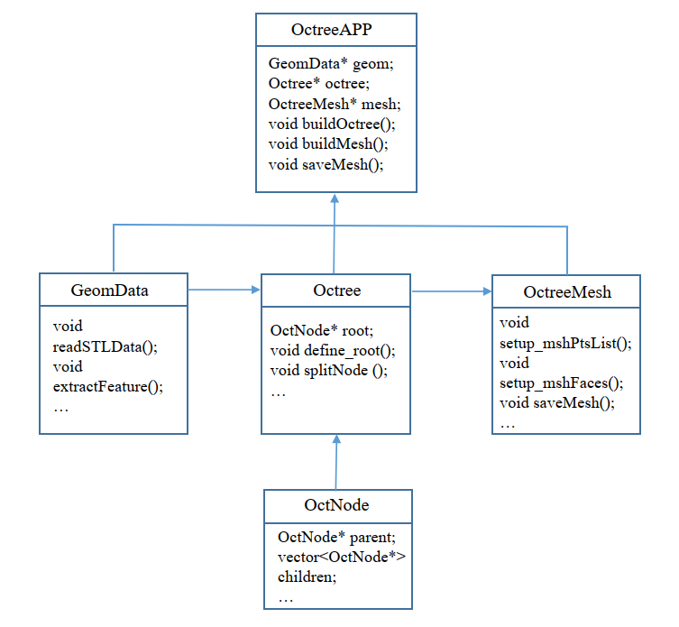
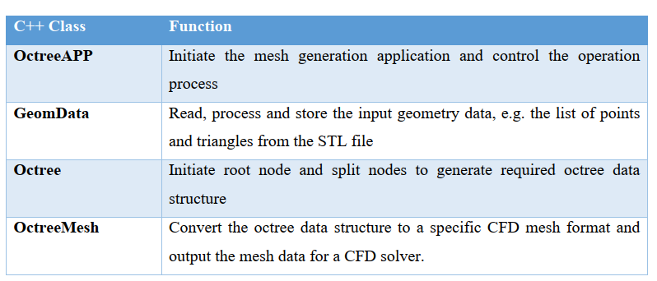
Octree-based hybrid mesh generation algorithm
Algorithm design and implementation
Page 10
Sub-blocks are no longer prerequisite for mesh generation;
Each mesh element can be manipulated due to the tree data structure feature;
Each mesh element is dividable.

Slide 12
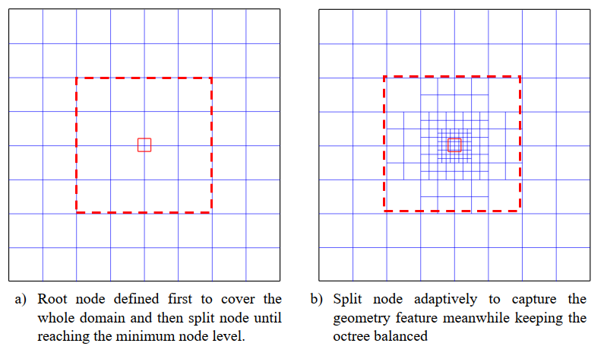
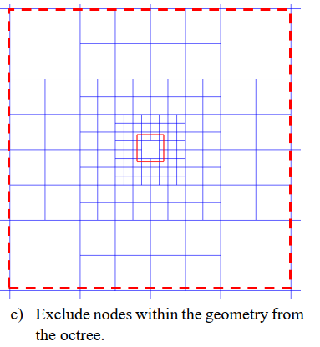
Octree-based hybrid mesh generation algorithm
Example
Page 11

Slide 13
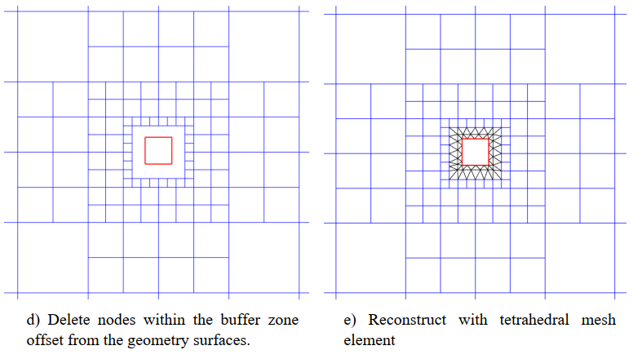
Octree-based hybrid mesh generation algorithm
The way forward
Page 12

